Slide 1
Point-set Distances for Learning Representations of 3D Point Clouds
21 ICCV
VinAI Research, Vietnam

Slide 2
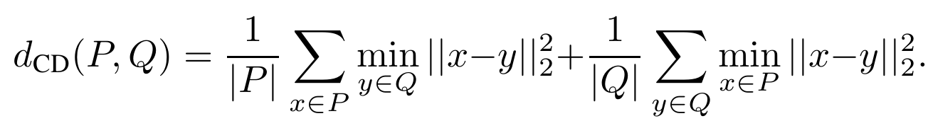
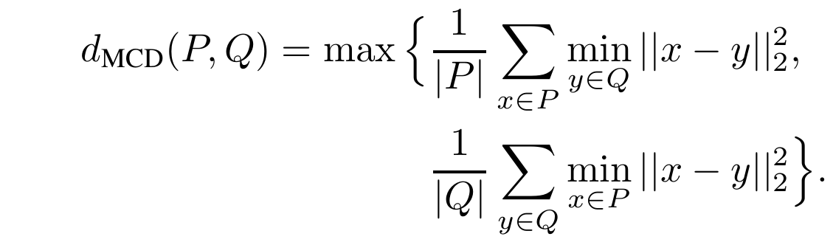
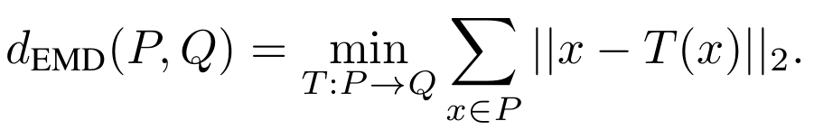
Measures between point sets:
Chamfer distance:
Earth mover’s distance:
The Earth mover’s distance can be considered as a specific case of Wasserstein distance.

Slide 3
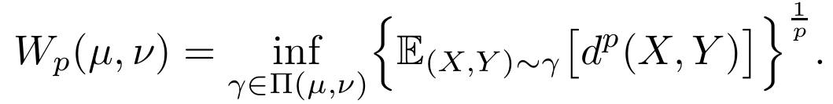
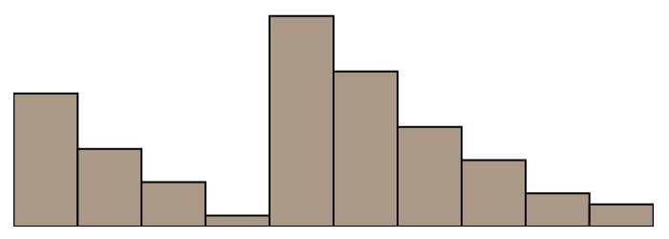
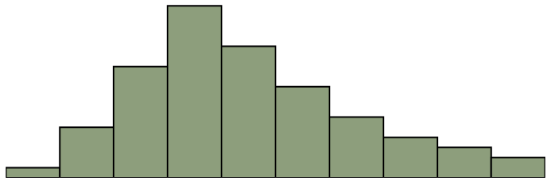


Wasserstein distance:
Let ($Ω,d$) be a metric space, $μ,ν$ are probability measures on $Ω$. For $p≥1$, the $p$–Wasserstein distance (WD) is given by:
Smaller distance?
Larger distance?
$$P$$
$$Q$$
Notes:
Wasserstein distance的定义如下，d是X和Y之间的距离度量，γ是X和Y的联合分布，我们要找到一个最优的联合分布γ使得X到Y的距离平均最小，
可以视作下面这个问题，如何将上面的分布P通过某种变换得到下面的分布Q，这种变换是有代价的，我们想找到代价最小的变换，Wasserstein distance就定义为这个最小的代价

Slide 4
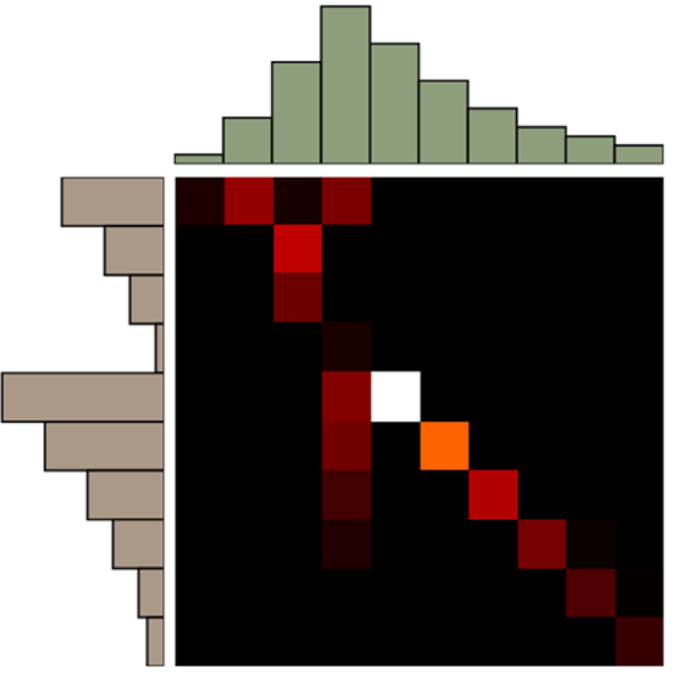
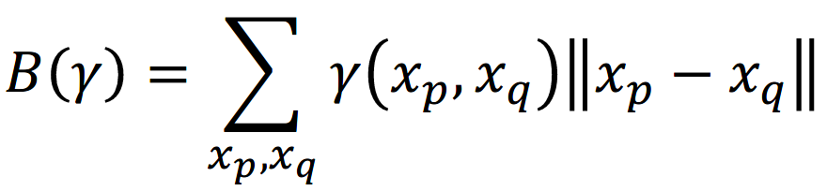

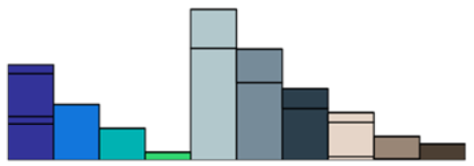
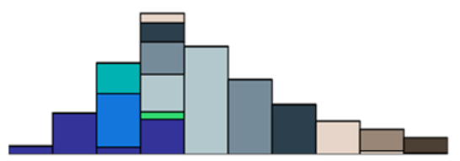
The total distance of a plan:
The Wasserstein distance:
Notes:
或者看这张图更加清楚，伽马看做是从xp点搬运多少放在xq点，而||xp-xq||这项则是该搬运的距离，我们想要的就是找到一个代价最小的搬运方式

Slide 5
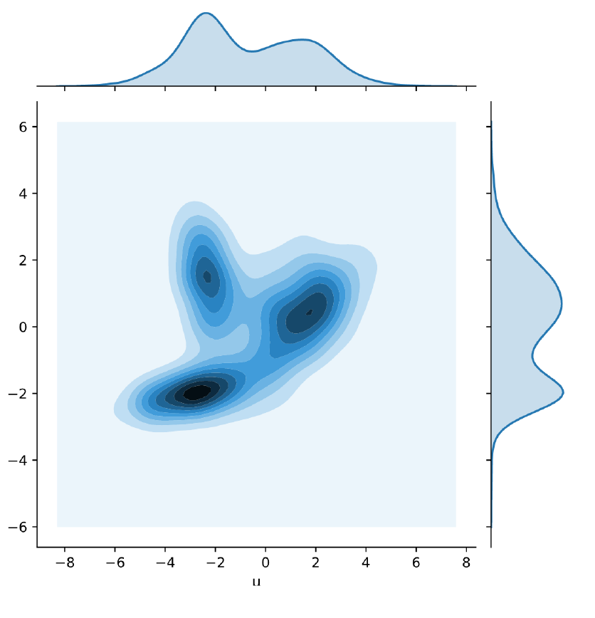
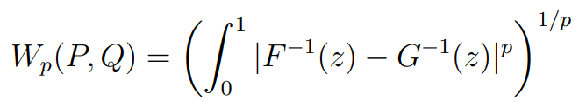
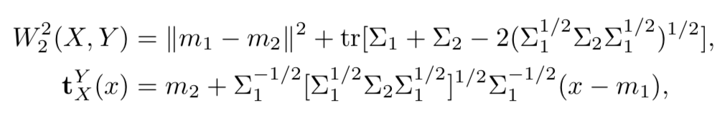
Two cases with analytic solutions:
d=1:
Gaussian distribution:
Notes:
将这种离散的分布变成连续的分布，γ就可以看做是关于p和q的联合分布，在两种情况下，上面的式子是有解析解的，

Slide 6


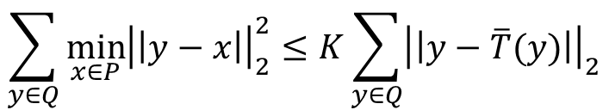
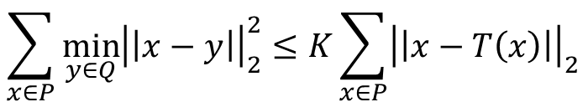
Relation between Chamfer divergence and Earth Mover’s distance
Lemma: Assume |P|=|Q| and the support of P and Q is bounded in a convex hull of diameter K, then we find that:
$$d_{CD}\left(P,Q\right)≤2Kd_{EMD}(P,Q)$$
Prove: Assume that T is the optimal plan from P to Q. Then, we find that:
$$\min_{y∈Q}{{\left|\left|x−y\right|\right|}_{2}≤{\left|\left|x−T\left(x\right)\right|\right|}_{2}}⇒\min_{y∈Q}{{\left|\left|x−y\right|\right|}_{2}^{2}≤{K\left|\left|x−T\left(x\right)\right|\right|}_{2}}$$
Since ${\left|\left|x−T\left(x\right)\right|\right|}_{2}≤K$. Taking the sum over $x$, we obtain:
$$\sum_{x∈P}{\min_{y∈Q}{{\left|\left|x−y\right|\right|}_{2}^{2}}}≤K\sum_{x∈P}{{\left|\left|x−T\left(x\right)\right|\right|}_{2}}$$
$$\sum_{y∈Q}{\min_{x∈P}{{\left|\left|y−x\right|\right|}_{2}^{2}}}≤K\sum_{y∈Q}{{\left|\left|y−\overline{T}(y)\right|\right|}_{2}}$$
Minimizing the Wasserstein distance leads to a smaller Chamfer discrepancy, and the reverse inequality is not true.
$$d_{CD}\left(P,Q\right)≤2Kd_{EMD}(P,Q)$$

Slide 7
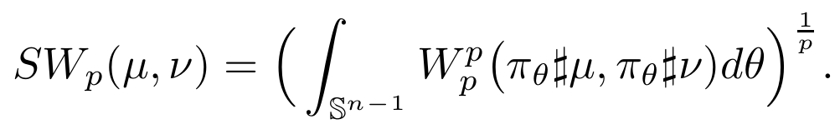
Sliced Wasserstein distance
The Sliced Wasserstein distance is considered as a low-cost approximation for Wasserstein distance.
Project both target probability measures µ and ν on a direction, says θ, on the unit sphere to obtain two projected measures denoted by πθ♯µ and πθ♯ν, respectively.
Compute the Wasserstein distance between two projected measures πθ♯µ and πθ♯ν.
taking the average of the Wasserstein distance between the two projected measures over all possible projected direction θ.
When $p$ = 1, the $SW_{p}$ is weakly equivalent to first order WD or equivalently EMD.
θ
1D Wasserstein distance

Slide 8
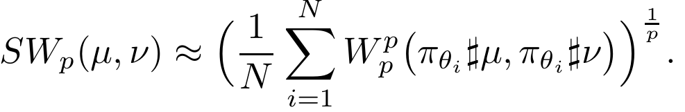
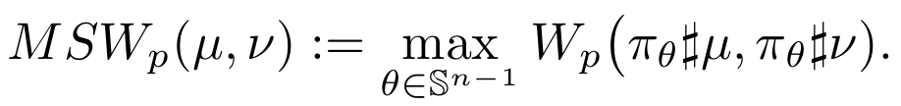
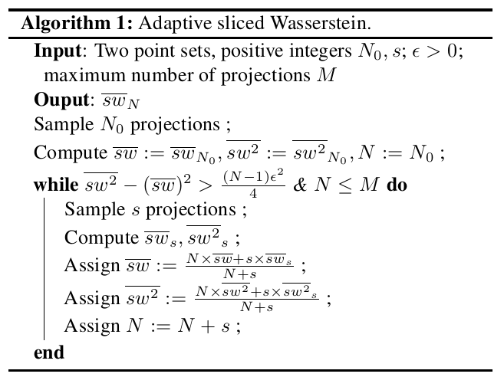
Sliced Wasserstein distance
Monte Carlo estimation.
Max-sliced Wasserstein distance.
Adaptive-sliced Wasserstein algorithm
dynamically determine the number of projections N from the observed mean and variance of the estimators.

Slide 9
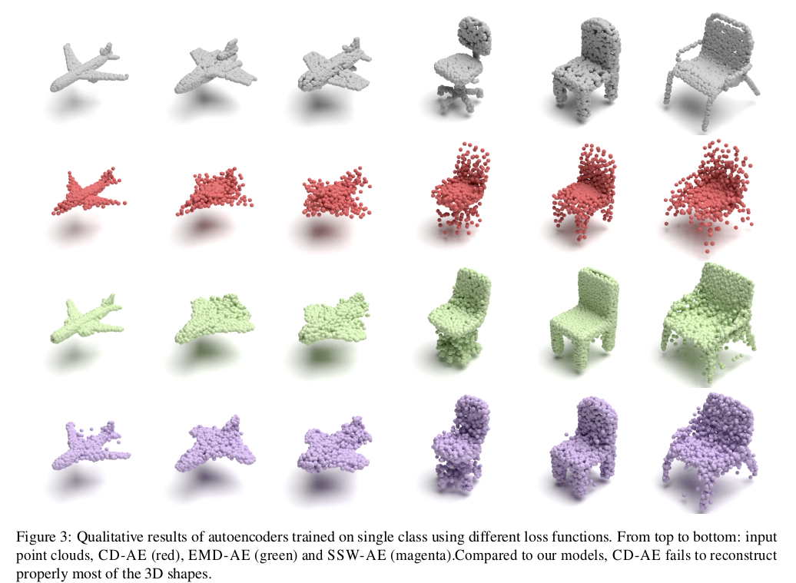

Slide 10
